Slide 1

Big Mountain Ski Resort Data Science Analysis
Trent Leslie

Slide 2

AGENDA
Problem Identification
Recommendation & Key Findings
Modeling Results & Analysis
Summary & Conclusion

Slide 3
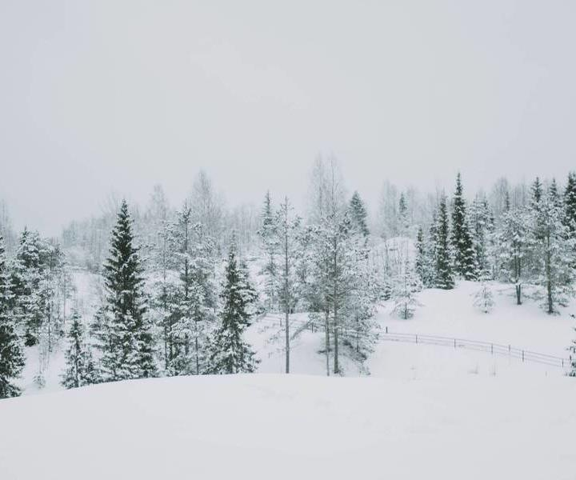
Problem Identification
Given its facilities, what are appropriate weekday and weekend ticket prices for Big Mountain Resort in the 2021-2022 season? Further, what are two high impact changes that could be implemented in the 2021-2022 season that would either reduce costs or justify higher ticket prices?

Slide 4
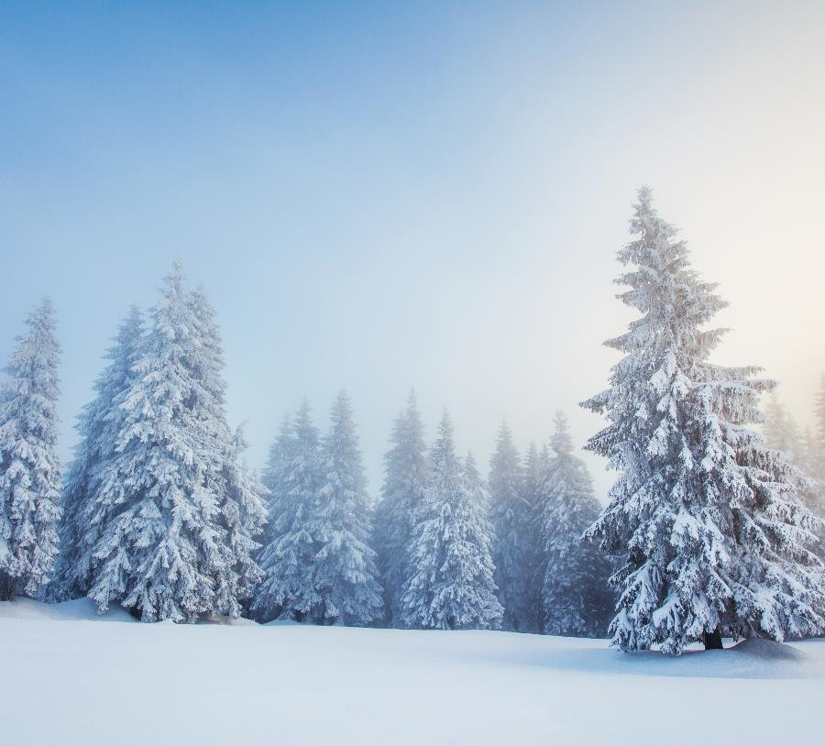

Introduction
Big Mountain Resort has recently installed an additional chair lift that increases their operating costs by $1,540,000 this season.
There is a suspicion that Big Mountain is not capitalizing on its facilities as much as it could.
The business wants some guidance on how to select a better value for their ticket price and identify changes that may either cut costs without undermining the ticket price or will support an even higher ticket price.

Slide 5


Recommendations & Key Findings
The selected model suggests ticket price is driven by what Big Mountain is among the best at - snow making acreage, total skiable terrain, fast quads, vertical rise, and total runs.
As such, the selected model suggests the market can support a ticket price of ~$96 (MAE = ~$10).
Every dollar in ticket price increase from $81 is expected to contribute ~$1.75 million for operating costs of the new chair lift and the bottom line.
With respect to the potential scenarios for improving the bottom line, the model suggests the second of potential scenarios - increasing vertical drop with the installation of an additional chair lift - is worth further consideration. It would justify a further increase of ticket price of ~$2.
Finally, the selected model suggests that the business could also further consider closing the least used run to start.

Slide 6

Modeling Results & Analysis
Annual revenue growth

Slide 7
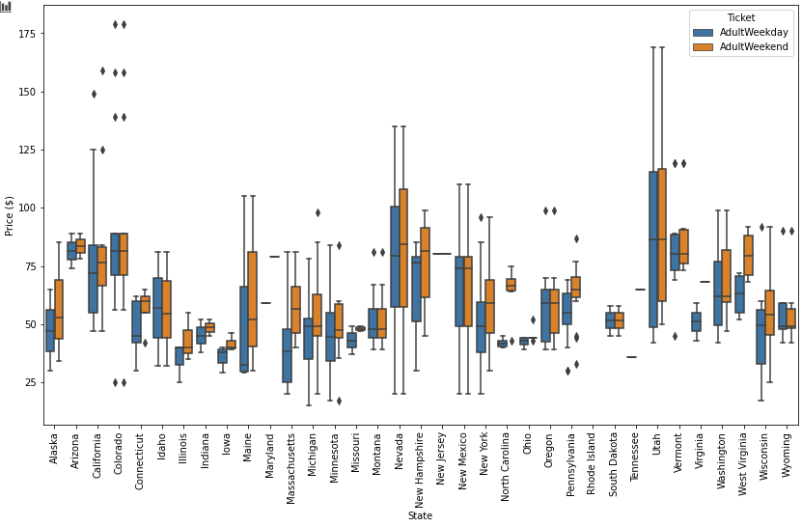
Weekday vs. Weekend Ticket Prices By State

Slide 8
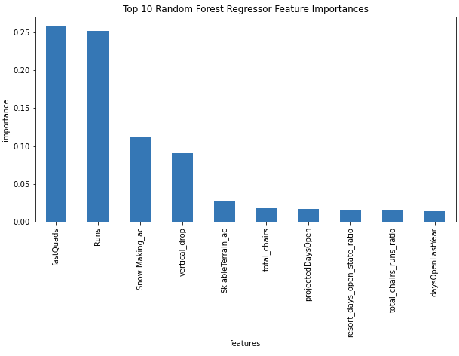
Most Important Features of Selected Model
The selected model suggests ticket price is driven by what Big Mountain is among the best at:
Fast Quads
Total Runs
Snow Making Acreage
Vertical Rise
Total Skiable Terrain

Slide 9
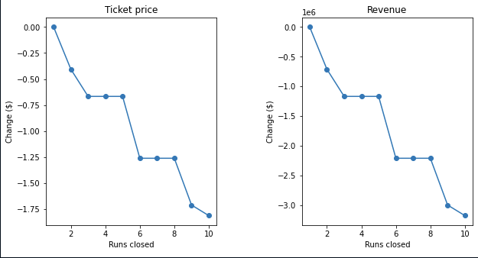
Effect of Closing Runs on Ticket Price and Revenue
The selected model suggests closing one run would have no effect on ticket price and revenue.

Slide 10
Summary & Conclusion
There is a suspicion that Big Mountain is not capitalizing on its facilities as much as it could.
The selected model suggests ticket price is driven by what Big Mountain is among the best at - snow making acreage, total skiable terrain, fast quads, vertical rise, and total runs.
As such, the selected model suggests the market can support a ticket price of ~$96 (MAE = ~$10).
The model suggests the second of potential scenarios - increasing vertical drop with the installation of an additional chair lift - is worth further consideration. It would justify a further increase of ticket price of ~$2.
Finally, the selected model suggests that the business could also further consider closing the least used run to start.

Slide 11
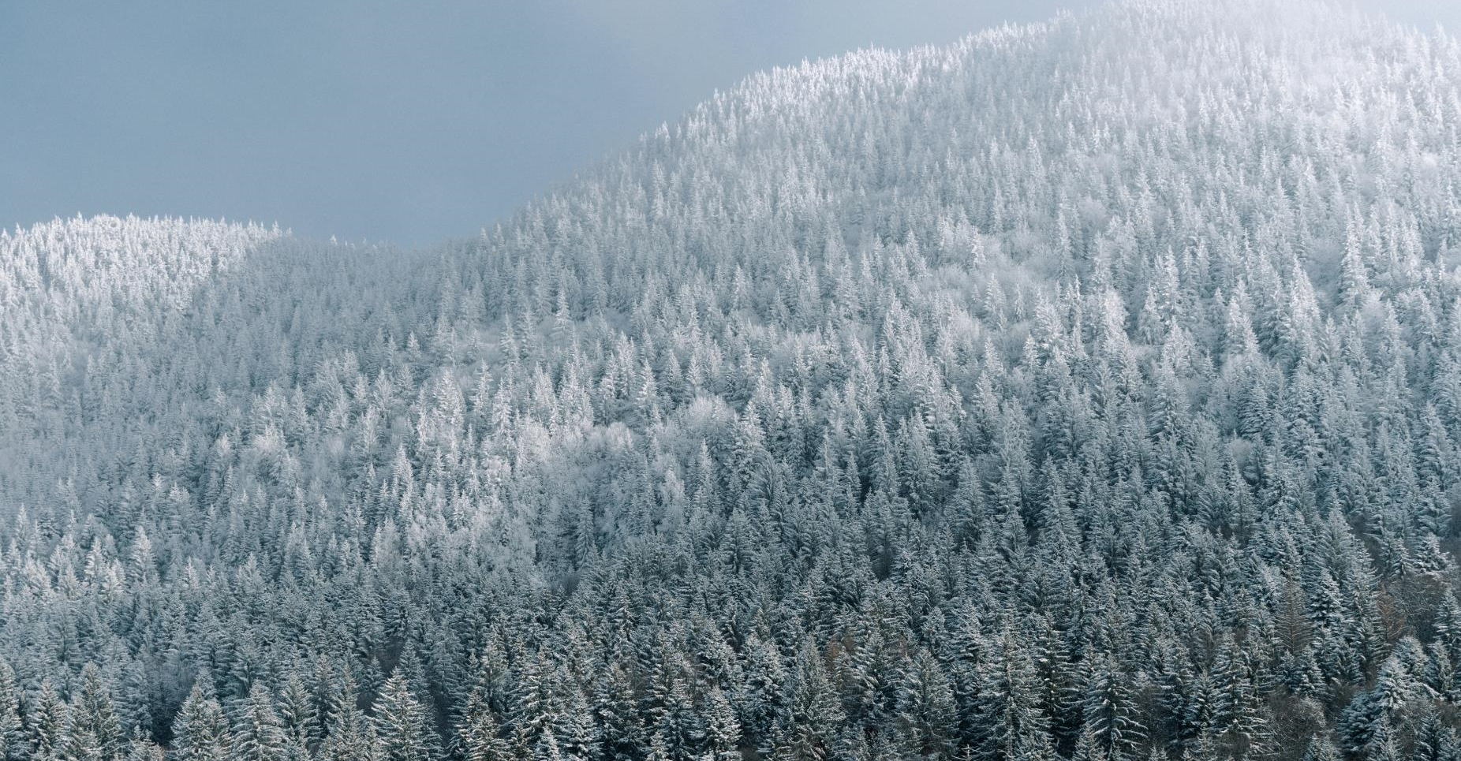
THANK YOU

